Slide 1


UNLOCKING INSIGHTS:
NYC TAXI TRENDS
and the impact of covid
Group 4: Aryan Kumar, Jenn Hong, Olimpia Borgohain,
Saumya Anand, Setu Shah

Slide 2
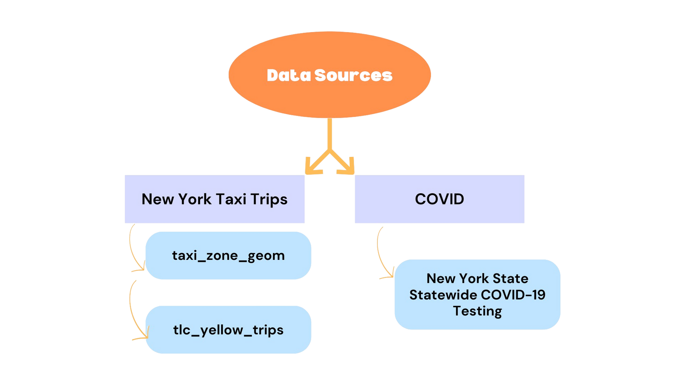

DATA OVERVIEW

Slide 3
DATA CLEANING
Data from 2019, 2020, 2021, and 2022 were chosen
Organized into our time frames for further analysis:
March 2019 - March 2020: Pre-COVID
March 2020 - March 2021: Active-COVID
March 2021 - March 2022: “Post”-COVID
Aggregated “daily_df” to improve computation efficiency

Slide 4
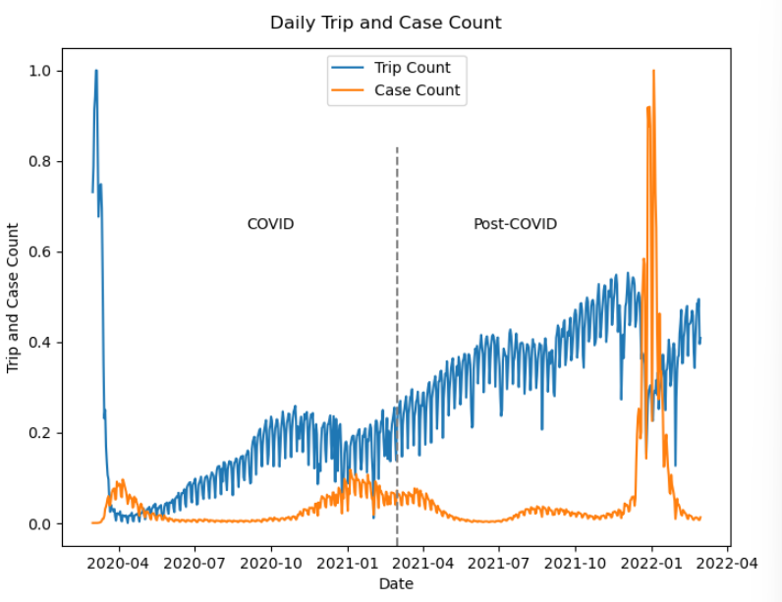
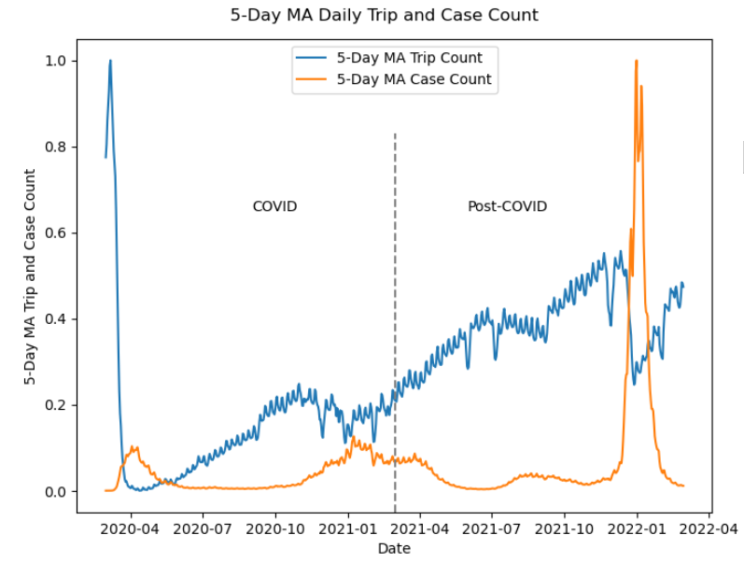
Marketplace overview

Slide 5
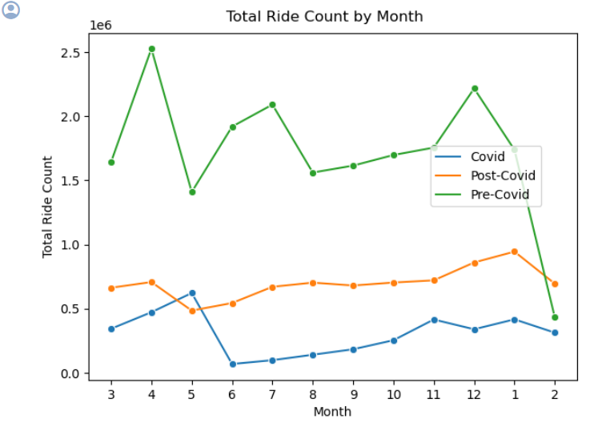
Total ride count
Pre-COVID months are loosely linked to seasonality with warmer months, June and July, seeing more rides.
COVID ride counts see peak in May, aligning with reopening timelines for NYC but there’s a sharp drop in June.
Post-COVID ride counts tend to trend generally upwards, suggesting a slow but steady recovery in taxi ridership.

Slide 6
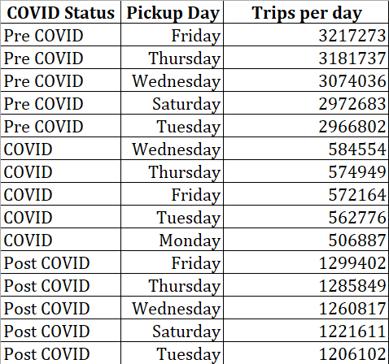
Popular pickup days for each period
Pre-Covid Period: Fridays had the highest number of pickups, followed by Thursdays and Wednesdays.
Covid Period: Wednesdays had the most popular pickup day, closely followed by Thursdays and Fridays.
Post-Covid Period: Fridays once again stood out as the peak pickup day, with Thursdays and Wednesdays following closely behind.

Slide 7
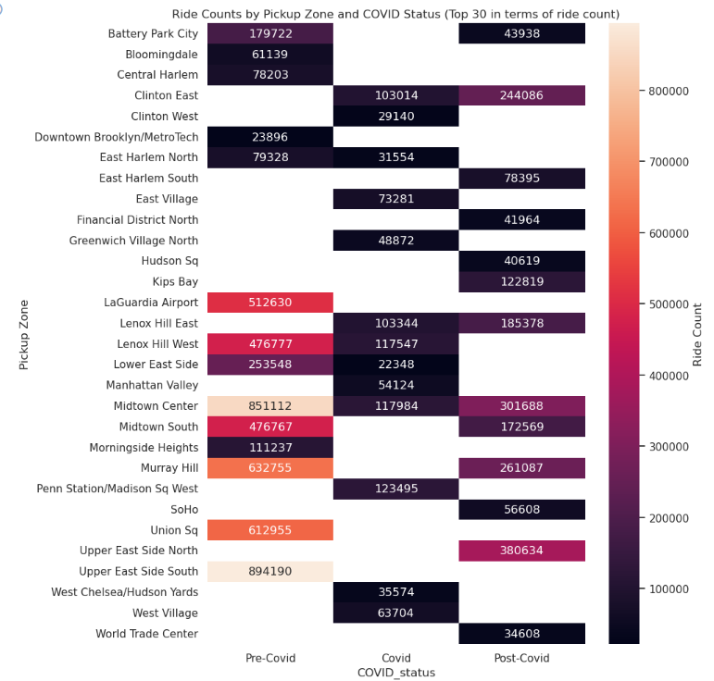
popular zones and
covid phases

Slide 8

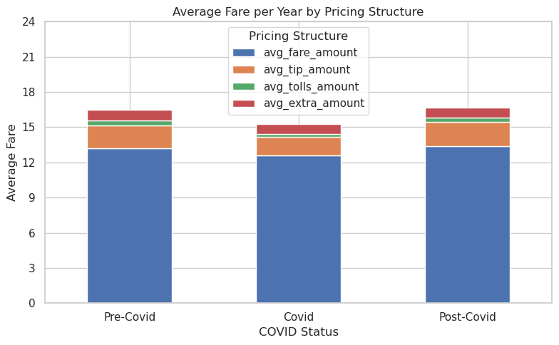
Money Matters
Pre-Covid
19.52
Maybe due to change in pricing strategies during reduced demand
Recovering and past initial fares!
Avg Total Amount
Covid
18.14
Post-Covid
19.88
Pricing Structure
Breakdown follows similar pattern throughout the phases
Average fare amount remained the highest

Slide 9
So what is affecting the change in prices?
We analyzed the patterns in average distance, ancillary fees and trip duration
This closely follows the pattern in change in price, indicating its effect on it.
For NYC Taxi rides, after a base fare, the meter runs based on either time or distance travelled.
Pre-Covid
17.97
Avg Trip Duration (mins)
Covid
14.83
Post-Covid
16.54
People were travelling for longer distances during and post covid
People moved outside cities and don't have to come to office everyday
Pre-Covid
2.57
Avg Distance
Covid
3.93
Post-Covid
6.38

Slide 10
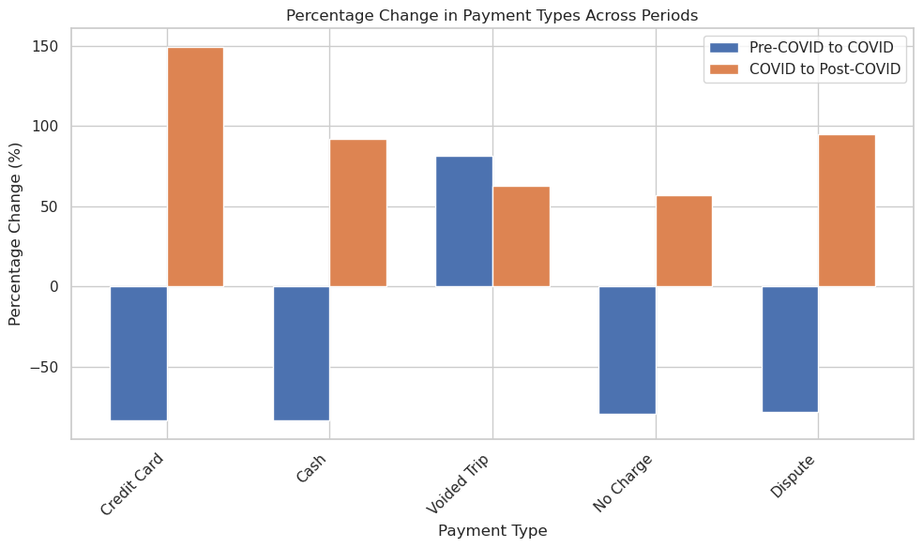
Payment Type Breakdown Across the Phases
Number of transactions using Credit Card and Cash dominated. Some other types were voided trips, no charge and disputed transactions.
Most of the payment types saw a jump from Covid to Post-Covid
Credit cards saw highest increase. People preferred digital payments after covid

Slide 11
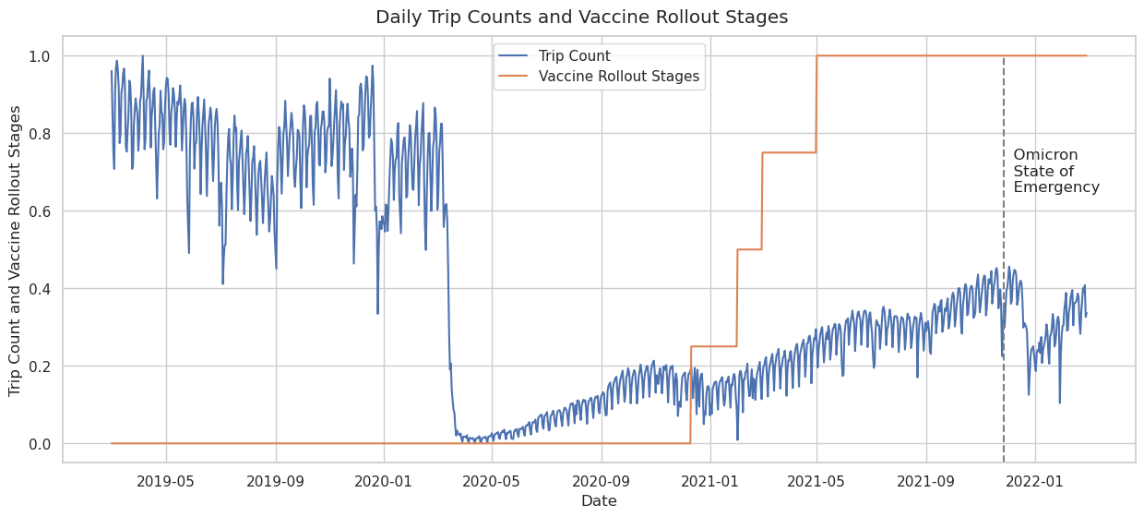
IMPACt of vaccine rollouts
After the first phase of vaccine rollouts starting in November 2020, ride counts remain stable.
However, with subsequent phases, ride counts trend upwards showing sustained recovery of the industry as things returned back to “normal.”
We see a drop-off again when the Omicron wave hits in late 2021.

Slide 12
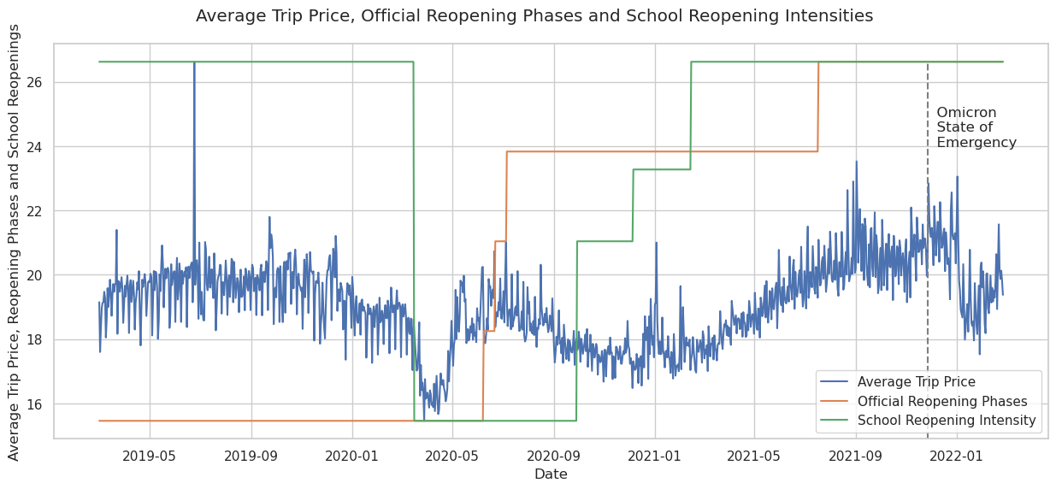
IMPACt on average fares
We observe an immediate ~15% dip in fares as the pandemic hits. However, they rebound rapidly to pre-pandemic levels as lockdown ends.
Once more restrictions are lifted, we can see a downward tend in fares. This is because of less traffic congestion!
From mid-2021 as things get back to normal, we see an upward trend as fare prices were hiked due to inflation.

Slide 13
predicting daily demand using ML
Baseline Model RMSE
3583
Random Forest
Fine Tuned Model RMSE
2905
Feature Importance
Passenger Counts
Total New Positive Cases
Average Total Cases per 100k
Limitations
25% sample
Memory limitations
Backtesting

Slide 14
CoNCLUSION
Mobility Patterns: Average trip distance increased during COVID but increased triple post-COVID
Fares increased post covid
Average duration of trips decreased post covid
Payment Preferences: Credit card and cash transactions remained popular throughout
Key Hub Analysis: The Upper East Side remained a key hub for taxi rides
Commuting Habits: Pickup hour distributions changed

Slide 15

Challenges / Limitations
Size of the Dataset
Yellow Taxi Data
JSON Parsing Error
Monthly Averages not normalized

Slide 16

Thank You!

